Slide 1

ACI Logical, resolved concrete model
Roland Ducomble - rducombl@cisco.com
TS technical Leader – CCIE 3745
Dec 2014
V2.0
Notes:
V1.0 : Last updated : 10th Dec 2014
V2.0: Last update 14th Jan 2015

Slide 2
Agenda
What are Logical, Resolved & Concrete Models?
Model Conversion Workflow
Step 1: Logical Model Configured by User
Step 2: Logical Model converted to Resolved Model
Step 3: Resolved Model converted to Concrete Model
Troubleshooting logic
Visore Screenshots
GUI Screenshots
Class in object tree summary
Complete example (Moquery)
Q&A

Slide 3
What are Logical, Resolved & Concrete Models?
Logical Model: Model configured by User in APIC using GUI or XML/JSON API.
Resolved Model: Model used for passing information/configuration from APIC to switches (Leaves & Spines). This model is user visible but not configurable. Its implicitly configured by APIC.
Concrete Model: Model on which iNXOS acts on. This model is also user visible but not configurable.

Slide 4
Model Conversion Workflow
1.Configured by User
Logical Model
2. Converted by APIC
Resolved Model
3. Converted by APIC/PE
Concrete Model
4. Triggers sent to NXOS for
hardware programming
Hardware
Some models are directly converted from logical to concrete by agent running on the laves & spines.
1. Logical Model: Configured by User.
2. Logical Model is converted to Resolved Model by APIC. This resolved model is then sent to the leaves & spines.
Resolved Model exists only for sending tenant configuration such as Epg, BD, Ctx. Other configurations like Selectors are sent as is to the fabric nodes (Represented by red line).
3. Resolved Model is converted by Policy Element (APIC agent running on leaves/spines) to Concrete Model.
4. Creation of Concrete Model sends notifications to the iNXOS for programming hardware.

Slide 5
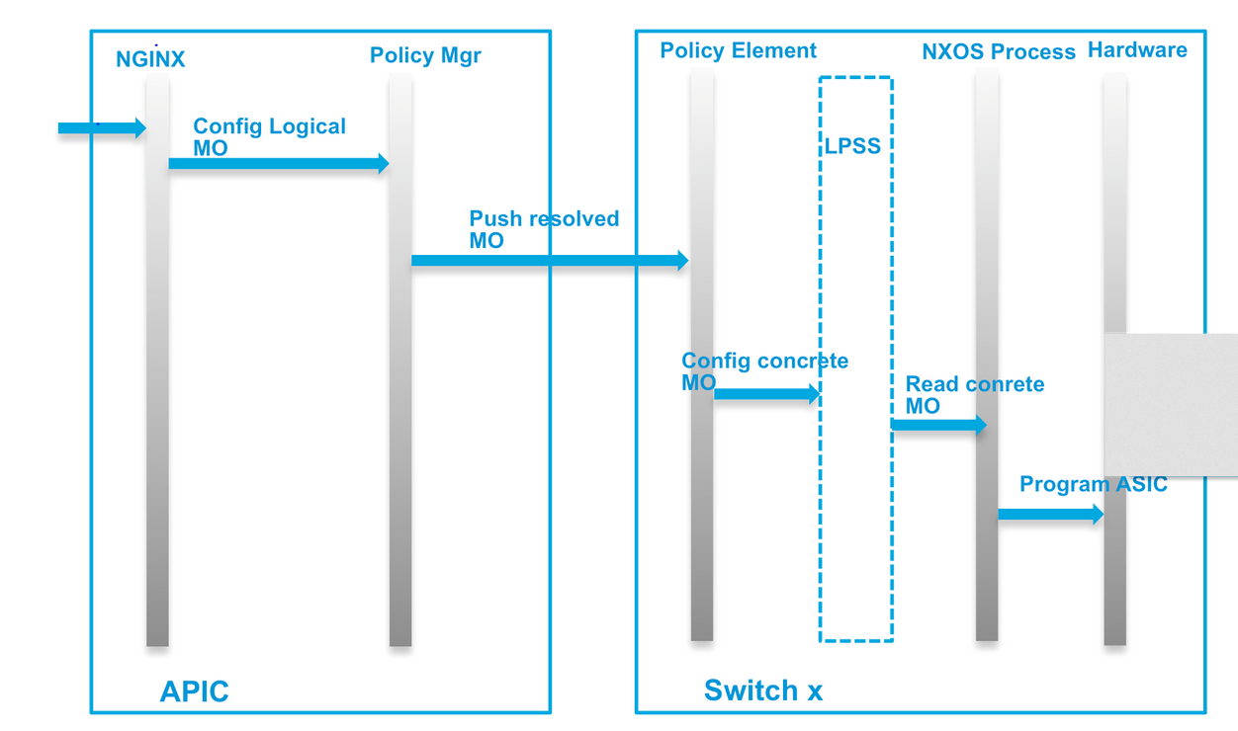
Logical – Resolved – Concrete model

Slide 6
Logical – Resolved – Concrete model MO localisation in file structure
APIC view :
/mit/topology/pod-1/node-x/sys/...
On switch:
/mit/sys/...
Switch:
/mit/uni/epp
/mit/uni/ctx..
/mit/uni/bd..
APIC:
/aci/..
APIC:
/mit/uni/epp
/mit/uni/ctx-..
/mit/uni/bd..
Switch CLI
And vsh_lc CLI

Slide 7
Logical Model Configured By User EPg Containment Hierarchy
fvTenant
fvAp
fvAEPg
fvAEPg
fvRsBd
fvRsBd
fvBD
fvCtx
fvRsCtx
tn-coke
ap-default
epg-App
Notes:
Application profile is a logical collection of Epgs participating to a provide a service. Example: “www.coke.com” could be an application profile which is provided by three EPgs named “App”, “Web” and “DB”.
fvBD: Bridge Domain
fvCtx: Private Network aka Virtual Routing and Forwarding Instance (VRF)
fvRsBd: Represents the relation to the Bridge Domain associated with the Epg.
fvRsCtx: Represents the relation to the Private Network associated with the Bridge Domain

Slide 8
Logical Model Converted to Resolved Model
Endpoint Profile (EpP)
fvEpPCont
fvEpP
fvLocale
fvEpP
fvLocale
fvStPathAtt
fvDyPathAtt
fvIfConn
fvIfConn
Internal deployment profile for Epg
Deployed to node / policyelement
epp
Every Epg has an fvEpP class
fv-[uni/tn-coke/ap-default/epg-App]
There is an fvLocale for each leaf that needs the Epg
fv-[uni/tn-coke/ap-default/epg-App]/node-102
fv-[uni/tn-coke/ap-default/epg-App]/node-102/stpathatt-[eth1/10]
Or
fv-[uni/tn-coke/ap-default/epg-App]/node-102/dyatt-[topology/pod-1/paths-102/pathep-[eth1/47]]
One fvStpathAtt for each Static path
One fvDyPathAtt for each host of the DVS(AVS) attached to the node in that Locale
fv-[uni/tn-coke/ap-default/epg-App]/node-102/stpathatt-[eth1/10]/conndef/conn-[vlan-19]-[0.0.0.0]
or
fv-[uni/tn-coke/ap-default/epg-App]/node-102/dyatt-[topology/pod-1/paths-102/pathep-[eth1/47]]/conndef/conn-[vxlan-8912897]-[0.0.0.0]
fvIfConn represents access encaps (vlan or vxlan)
Notes:
Every EPg has a corresponding EpP
EpP: An EpP is a container of summarized configuration of an EPg to be deployed on nodes.
Locale: EpP contains fvLocale which represents a node i.e. leaf or spine. fvLocale is a container of summarized configuration to be deployed on a node. – here two fvLocale will be created (one per node).
fvStPathAtt: Static Path Attachment on which the EpP has to be deployed. It could be a port/port-channel or vpc.
fvDyPathAtt: Dynamic Path Attachment on which EpP has to be deployed. It could be a port/port-channel or vpc. Its called Dynamic because its created based on the triggers coming dynamically from VM controller.
fvIfConn: Interface connectivity parameters. It represents the emcap, ip, mtu etc. information to be deployed on the path.

Slide 9
Logical Model Converted to Resolved Model
BD and Context (fvBDDef & fvCtxDef)
BDDef: Summarized internal representation of fvBD. Its naming property is the DN of the corresponding fvBD. It has BD identifiers like Segment ID, PcTag (policy control tag used for Contracts) etc. It also contains summarized internal representations of other BD policies like IGMP, DHCP, End Point Retention Policy etc.
CtxDef: Summarized internal representation of fvCtx. Its naming property is the DN of the corresponding fvCtx. Like BDDef it has Ctx identifiers like Segment ID and PcTag. It also contains summarized internal representations of other Ctx policies like End Point Retention Policy etc.
uni
fvBDDef
fvCtxDef
uni/bd-[uni/tn-mgmt/BD-inb]
uni/ctx-[uni/tn-mgmt/ctx-inb]

Slide 10
Resolved Model Converted to Concrete Model
sys
l3Ctx
vlanCktEp
l3Ctx
l2BD
l2BD
l2BD
vxlanCktEp
l2RsPathDomAtt
top::System, it’s the root of concrete model
Private network (aka VRF).
sys/ctx-[vxlan-2555904]
Bridge Domain
sys/ctx-[vxlan-2555904]/bd-[vxlan-15826914]
Encap i.e. VLAN OR VXLAN
sys/ctx-[vxlan-2555904]/bd-[vxlan-15826914]/vlan-[vlan-17]
Association from Encap to Port/Port-Channel
sys/ctx-[vxlan-2555904]/bd-[vxlan-15826914]/vlan-[vlan-17]/rspathDomAtt-[sys/conng/path-[eth1/16]]
Notes:
l3Ctx (a.k.a VRF )is the concrete representation of fvCtx. Segment Id of an l3Ctx is taken from fvCtxDef.
l2BD is the concrete representation of l2BD. Segment Id of an l2BD is taken from fvBDDef.
vlanCktEp/vxlanCktEp are the encapsulations on wire. Instantiation of this object creates a VLAN on switch . For instance, these encaps are taken from fvIfConn.
l2RsPathDomAtt:
Ports/PortChannels are considered as paths in APIC.
VLAN/VXLAN/BD are considered as Domains.
l2RsPathDomAtt is used for enabling a domain on a path. For instance, enabling vlan-17 on port 1/17.

Slide 11
Troubleshooting Logic
First Step -
Golden Rule: Always check for faults in the system. If anything fails deployment then faults are raised. For instance, if EPg deployment fails for any reason then faults will be raised on the EPg.
Second Step
Follow Logic : Logical Model → Resolved Model → Concrete objects
If some links or MO are missing, get relevant dme logs (see later slide)
Save a show tech of the 3 apics and impacted leaves
Third Step
Verify iNXOS using the iNXOS shell commands. (covered other sessions)

Slide 12
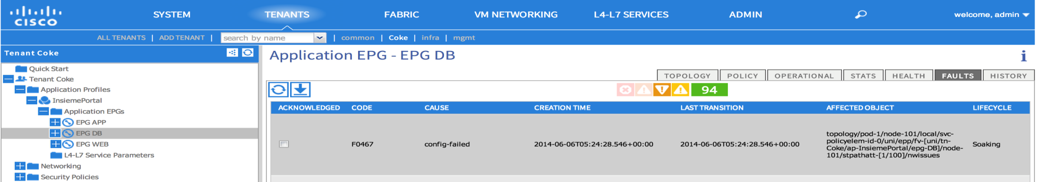
Step 1 - Fault Example
Example: User configured epg-DB on a non-existing path eth1/100. APIC validated the config and raised an “invalid-path” fault. The fault also shows the affected object.

Slide 13
Step 2- MO tree query options
Visore – easier to browse relation – harder for tac for offline analysis
moquery – harder to browse – easiest for TAC to get part of the MIT for offline analysis
Browse to directory and get cat summary
API :
Postman or curl to send REST GET
Cobra SDK
Relying on customer infra/tool unless we have VPN
GUI – a bit painful for browsing concrete model (mostly in Fabric Inventory Tab)

Slide 14
Which Logs ?
On APIC on which config was pushed :
/var/log/dme/log/nginx.bin.log
On each APIC
(at least shard master):
/var/log/dme/log/svc_ifc_policymgr.bin.log
On leaf:
/var/log/dme/log/svc_ifc_policyelem.bin.log
And svc_ifc_eventmgr.log
Log: Watch out some logs wraps quickly check oldlog as well and creation time
to get the right one

Slide 15
Grepping log
On APIC example looking for BD name bootcamp in tn-RD:
admin@bdsol-aci2-apic1:log> pwd
/var/log/dme/log
admin@bdsol-aci2-apic1:log> zgrep uni/tn-RD/BD-BD_bootcamp svc_ifc_policymgr.bin.*
svc_ifc_policymgr.bin.log.152.gz:<configConfMo dn="uni/tn-RD/BD-BD_bootcamp">
svc_ifc_policymgr.bin.log.152.gz:<fvBD arpFlood="no" bcastP="0.0.0.0" childAction="" descr="" dn="uni/tn-RD/BD-BD_bootcamp" lcOwn="local" mac="00:22:BD:F8:19:FF" modTs="never" monPolDn="" mtu="inherit" name="BD_bootcamp" ownerKey="" ownerTag="" pcTag="any" rn="" scope="0" seg="0" status="created" uid="0" unicastRoute="yes" unkMacUcastAct="proxy" unkMcastAct="flood">
svc_ifc_policymgr.bin.log.152.gz:<relnRelnResolveRespArgs childAction="" dn="" found="no" lcOwn="local" modTs="never" resolverDn="uni/tn-RD/BD-BD_bootcamp/rsbdToEpRet" rn="" status=""/>
svc_ifc_policymgr.bin.log.152.gz:<relnRelnResolveRespArgs childAction="" dn="" found="no" lcOwn="local" modTs="never" resolverDn="uni/tn-RD/BD-BD_bootcamp/rsigmpsn" rn="" status=""/>
svc_ifc_policymgr.bin.log.152.gz:<frmwrkReliableDeliveryResp childAction="" deliveryDn="uni/tn-RD/BD-BD_bootcamp/rsigmpsn" dn="" lcOwn="local" modTs="never" name="" rn="" status="" timestamp="1419861612726" type="rel-log" uid="0"/>
svc_ifc_policymgr.bin.log.152.gz:<frmwrkReliableDeliveryResp childAction="" deliveryDn="uni/tn-RD/BD-BD_bootcamp" dn="" lcOwn="local" modTs="never" name="" rn="" status="" timestamp="1419861612726" type="rel-log" uid="0"/>
svc_ifc_policymgr.bin.log.152.gz:<frmwrkReliableDeliveryResp childAction="" deliveryDn="uni/tn-RD/BD-BD_bootcamp/rsctx" dn="" lcOwn="local" modTs="never" name="" rn="" status="" timestamp="1419861612726" type="rel-log" uid="0"/>
svc_ifc_policymgr.bin.log.152.gz:<frmwrkReliableDeliveryResp childAction="" deliveryDn="uni/tn-RD/BD-BD_bootcamp/rsbdToEpRet" dn="" lcOwn="local" modTs="never" name="" rn="" status="" timestamp="1419861612726" type="rel-log" uid="0"/>
svc_ifc_policymgr.bin.log.152.gz:<actionUpdate dn="idm/runi-class-2818051/ctx-[res/subj-[uni/tn-RD/BD-BD_bootcamp]/reqctx-pcTag-2818051/idcon-class-2818051]" action="107" run="28" stage="52" timestamp="1419861612924">

Slide 16
Visore ScreenShots

Slide 17
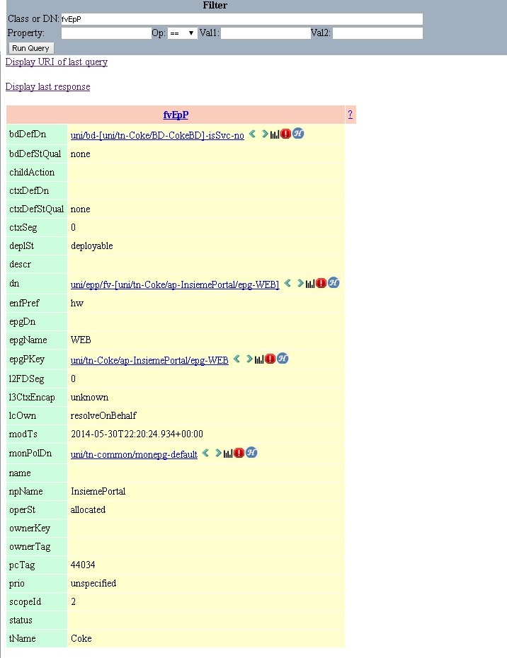
DN of the BDDef used by this EpP
Here Resolved model object
For an Epg (fvEpP)
DN of the CtxDef used by this EpP
Use arrow to browse the parent/child hierarchy
DN of the Epg corresponding to this EpP
Other EPg parameters
Click on link to jump to different
Part of the MIT:
To the Resolved BD
To the Logical Epg

Slide 18
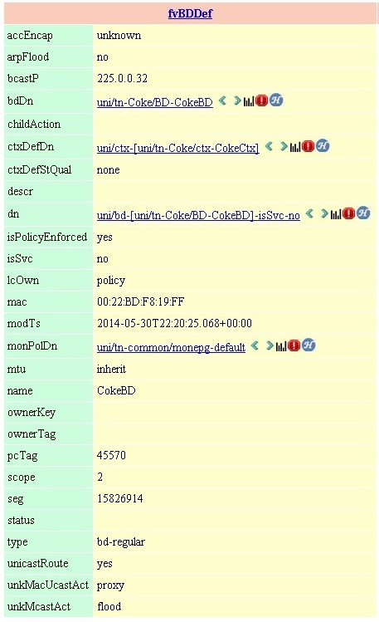
fv::BDDef: Resolved object representing fv::BD
DN of the fv::BD
DN of the fv::CtxDef used by this BD
Other BD parameters

Slide 19
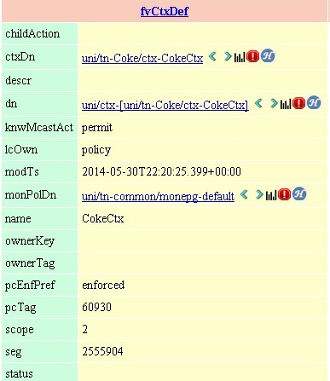
fv::CtxDef: Resolved object representing fv::Ctx
DN of the fv::Ctx
Other Ctx parameters

Slide 20
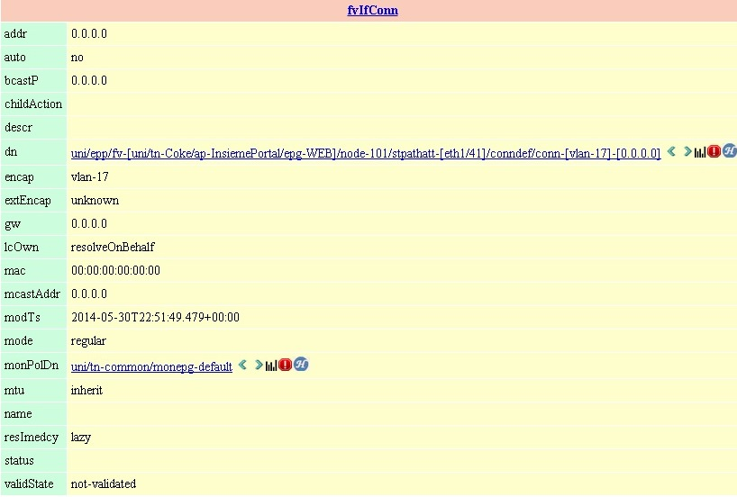
fv::IfConn: Resolved object representing interface connectivity properties.
To be applied on eth1/41 on node 101
encap

Slide 21
Debug API
This slide lists down the example apis which can be used to query resolved, concrete models. In general API topic will be covered as part of another session.
Query all EpPs: http://<apic ip or leaf ip>/api/node/class/fvEpP.xml
fvEpP is the class name of an End Point Profile. For querying other classes you can simply change the class name. For example, use fvLocale for querying all locales.
2. Query all EpPs with their direct children:
http://<apic ip or leaf ip>/api/node/class/fvEpP.xml?query-target=children
3. Query all EpPs with their subtrees (subtree includes grand children and so on …):
http://<apic ip or leaf ip>/api/node/class/fvEpP.xml?query-target=subtree

Slide 22
Debug API (contd)
4. Query all Path attachments under a known EpP:
http://<apic ip or leaf ip>/api/node/mo/uni/epp/fv-[uni/tn-Coke/ap-InsiemePortal/epg-DB]/node-101.xml?query-target=children
It looks for all path attachments under the given EpP and to be deployed on node 101.
5. Query whole subtree under a known EpP:
http://<apic ip or leaf ip>/api/node/mo/uni/epp/fv-[uni/tn-Coke/ap-InsiemePortal/epg-DB]/node-101.xml?query-target=subtree
It looks for all the Mos including the subtree under the given EpP and to be deployed on node 101.

Slide 23
GUI ScreenShots

Slide 24
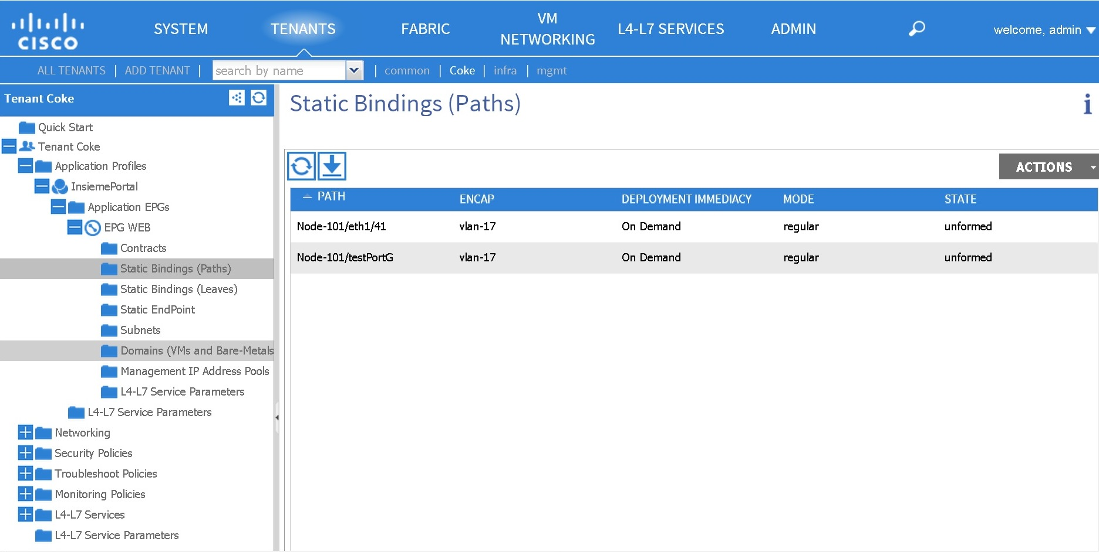
EPg Configuration: Logical Model

Slide 25
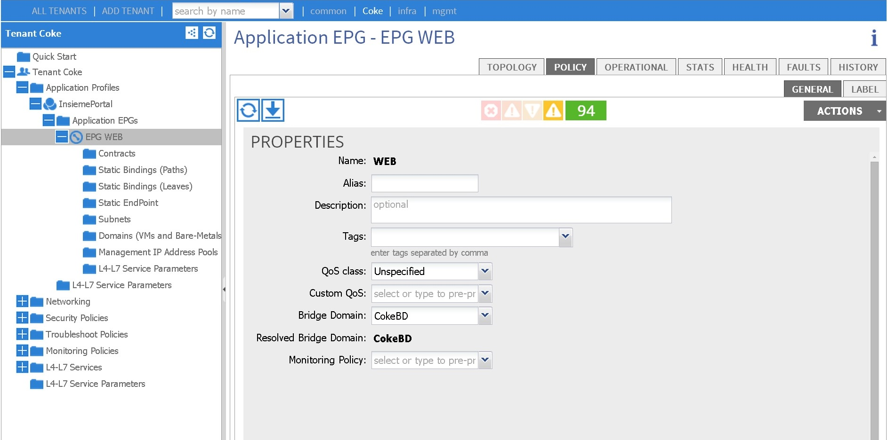
EPg/Bridge Domain Configuration: Logical Model

Slide 26
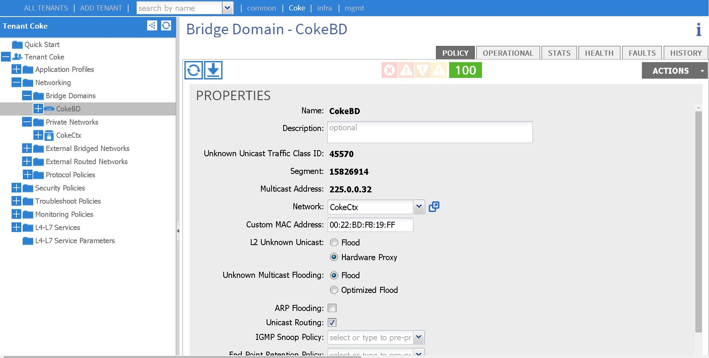
Bridge Domain/Private Network Configuration: Logical Model

Slide 27
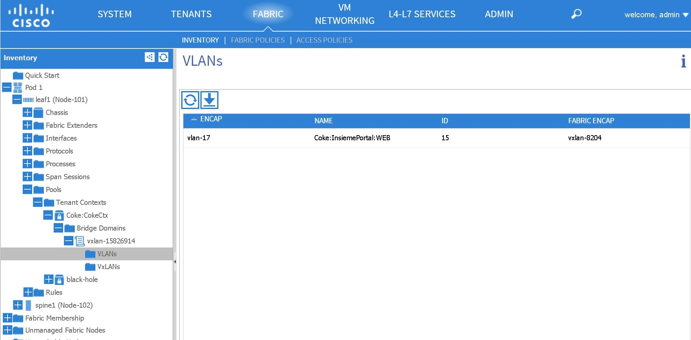
Display of Concrete Model

Slide 28
Summary of Important Classes

Slide 29
Logical model class
fvTenant
fvAp
fvAEPg
fvRsBd
fvBd
fvRsCtx
fvCtx
fvSubnet
…

Slide 30
Resolved model classes
fvTenant
fvAp
fvAEPg
fvRsBd
fvBd
fvRsCtx
fvCtx
fvSubnet
…
fvCtxDef
fvBDDeg
fvEpP
fvlocale
fvStPathAtt
fvDyPathAtt
fvIfconn

Slide 31
Resolved model classes
On switch :
fvCtxDef
fvBDDeg
fvEpP
fvlocale
fvStPathAtt
fvDyPathAtt
fvIfconn
fvTenant
fvAp
fvAEPg
fvRsBd
fvBd
fvRsCtx
fvCtx
fvSubnet
…
fvCtxDef
fvBDDeg
fvEpP
fvlocale
fvStPathAtt
fvDyPathAtt
fvIfconn

Slide 32
Concrete model class
On switch :
fvCtxDef
fvBDDeg
fvEpP
fvlocale
fvStPathAtt
fvDyPathAtt
fvIfconn
On switch(or APIC)
l3Ctx
l2BD
vlanCktEp
vxlanCktEp
l2RtDomIfConn
vlanRsPathDomAtt
vlanRsVlanEppAtt
vxlanRsVxlanEppAtt
fvTenant
fvAp
fvAEPg
fvRsBd
fvBd
fvRsCtx
fvCtx
fvSubnet
…
fvCtxDef
fvBDDeg
fvEpP
fvlocale
fvStPathAtt
fvDyPathAtt
fvIfconn

Slide 33
Switch CLI
On switch :
fvCtxDef
fvBDDeg
fvEpP
fvlocale
fvStPathAtt
fvDyPathAtt
fvIfconn
On switch(or APIC)
l3Ctx
l2BD
vlanCktEp
vxlanCktEp
l2RtDomIfConn
vlanRsPathDomAtt
vlanRsVlanEppAtt
vxlanRsVxlanEppAtt
fvTenant
fvAp
fvAEPg
fvRsBd
fvBd
fvRsCtx
fvCtx
fvSubnet
…
fvCtxDef
fvBDDeg
fvEpP
fvlocale
fvStPathAtt
fvDyPathAtt
fvIfconn
On switch :
Show vlans
Show system internal epm …
Vsh_lc:
Show system internal eltmc info…
Show system internal epmc info

Slide 34
Mo logical and resolved mode relations
Tenant
fvTenant
Uni/tn-XX
Resolved EPG
fvEpP
uni/epp/fv-[uni/tn-XX/ap-XX/epg-XX]
Resolved BD
fvBDDef
uni/ctx-[uni/tn-XX/BD-YY]
ctxDefDn
Resolved Ctx
fvCtxDef
uni/ctx-[uni/tn-XXX/ctx-CCC]
epgPKey
bdDefDn
App Profile
fvAp
Uni/tn-XX/ap-NAME
bdDn
ctxDn
Specific Node instance
fvlocale
uni/epp/fv-[uni/tn-XX/ap-XX/epg-XX]/node-xxx
EPG
fvAEPg
uni/tn-xx/ap-XX/epg-NAME
BD
fvBD
Context (VRF)
fvCtx
tdn to BD
tdn to Ctx
Dyn Path
fvDyPathAtt
uni/epp/fv-[uni/tn-XX/ap-XX/epg-XX]/node-xxx/dyatt-[topology/pod-1/paths-nodeid/pathep-[ethx/x]]
Static \ Path
fvStPathAtt
uni/epp/fv-[uni/tn-XX/ap-XX/epg-XX]/node-xxx/stpathatt-[ethx/x]
Rel to BD
fvRsBd
Rel to Ctx
fvRsCtx
Encaps - fvIfConn
uni/epp/fv-[uni/tn-XX/ap-XX/epg-XX]/node-xxx/dyatt-[topology/pod-1/paths-nodeid/pathep-[ethx/x]]/conndef/conn-[vxlan….]]
Encaps -fvIfConn
uni/epp/fv-[uni/tn-XX/ap-XX/epg-XX]/node-xxx/stpathatt-[ethx/x]/conndef/conn-[vlan-xxx]..
tdn to physical port
x/x on nodeid
Notes:
MO creation needs as argument:
Parent object and name for the newly created MO
Dashed relationship (function starting by Rs) takes the child
MO has argument and needs a property with the name of the
Parent dashed relation.
We can found the property value in the managed obj doc for
The child object (eg tnFvBDName is found in doc for AEPg: http://mishield-bld.insieme.local/documentation/html/MO-fvAEPg.html#diagram

Slide 35
Mo Resolved to concrete (vlan Case here)
bdDefDn
ctxDefDn
Resolved EPG
fvEpP
Resolved BD
fvBDDef
bd_Seg_id
Resolved Ctx
fvCtxDef
Scope_id
Concrete Ctx
l3Ctx
Dn – topology/pod-1/node-x/sys/ctx-[vxlan-Ctx_scope]
bdDefDn
Specific Node instance
fvlocale
Concrete BD
l2BD
Dn – topology/pod-1/node-x/sys/ctx-[vxlan-Ctx_scope]/bd-[vxlan-bd_Seg_id]
tdn to EpP
(res EPG)
Dyn Path
fvDyPathAtt
Static \ Path
fvStPathAtt
Vlan Encaps
vlanCktEp
Dn – topology/pod-1/node-x/sys/ctx-[vxlan-Ctx_scope]/bd-[vxlan-bd_Seg_id]/vlan-[vlan-encap]
tdn to res Path
Encaps - fvIfConn
Encaps -fvIfConn
Vlan att to EPG
vlanRsVlanEppAtt
Vlan att to EPG
l2RtDomIfConn
Vlan att to EPG
vlanRsPathDomAtt
tdn to Phys Port
epgDn
To logical EPG
Physical port
nwPathEp

Slide 36
Mo Resolved to concrete (vxlan Case here)
bdDefDn
ctxDefDn
Resolved EPG
fvEpP
Resolved BD
fvBDDef
bd_Seg_id
Resolved Ctx
fvCtxDef
Scope_id
Concrete Ctx
l3Ctx
Dn – topology/pod-1/node-x/sys/ctx-[vxlan-Ctx_scope]
bdDefDn
Specific Node instance
fvLocale
Concrete BD
l2BD
Dn – topology/pod-1/node-x/sys/ctx-[vxlan-Ctx_scope]/bd-[vxlan-bd_Seg_id]
tdn to EpP
(res EPG)
Dyn Path
fvDyPathAtt
Vxlan Encaps
vxlanCktEp
Dn – topology/pod-1/node-x/sys/ctx-[vxlan-Ctx_scope]/bd-[vxlan-bd_Seg_id]/vxlan-[vxlan-encap]
Static \ Path
fvStPathAtt
Encaps - fvIfConn
tdn to dyn Path
Encaps
Vlan att to EPG
vxlanRsVxlanEppAtt
Vxlan att to EPG
l2RtDomIfConn
Vxlan att to EPG
vlanRsPathDomAtt
tdn to Phys Port
Encaps -fvIfConn
epgDn
To logical EPG
Physical port
nwPathEp

Slide 37
All classes together
Logical
Resolved
Concrete
bdDefDn
ctxDefDn
tdn to EpP
(res EPG)
fvTenant
fvEpP
fvBDDef
fvCtxDef
l3Ctx
epgPKey
fvAp
bdDefDn
ctxDn
l2BD
fvCtx
fvBD
bdDn
fvAEPg
epgDn
vxlanCktEp
vxlanRsVxlanEppAtt
epgDn
fvlocale
vlanCktEp
l2RtDomIfConn
vxlanRsPathDomAtt
fvRsCtx
fvDyPathAtt
fvStPathAtt
fvRsBd
nwPathEp
fvIfConn
fvIfConn
l2RtDomIfConn
vlanRsPathDomAtt
vlanRsVlanEppAtt
fabricPathEp
fabricLooseNode
nwPathEp
Notes:
MO creation needs as argument:
Parent object and name for the newly created MO
Dashed relationship (function starting by Rs) takes the child
MO has argument and needs a property with the name of the
Parent dashed relation.
We can found the property value in the managed obj doc for
The child object (eg tnFvBDName is found in doc for AEPg: http://mishield-bld.insieme.local/documentation/html/MO-fvAEPg.html#diagram

Slide 38
Complete Example – Moquery output

Slide 39
Context
bdDefDn
ctxDefDn
tdn to EpP
(res EPG)
fvTenant
fvEpP
fvBDDef
fvCtxDef
l3Ctx
epgPKey
fvAp
bdDefDn
ctxDn
l2BD
fvCtx
fvBD
bdDn
fvAEPg
epgDn
vxlanCktEp
vxlanRsVxlanEppAtt
epgDn
fvLocale
vlanCktEp
l2RtDomIfConn
vxlanRsPathDomAtt
fvRsCtx
fvDyPathAtt
fvStPathAtt
fvRsBd
nwPathEp
fvIfConn
fvIfConn
l2RtDomIfConn
vlanRsPathDomAtt
vlanRsVlanEppAtt
fabricPathEp
fabricLooseNode
nwPathEp
Notes:
MO creation needs as argument:
Parent object and name for the newly created MO
Dashed relationship (function starting by Rs) takes the child
MO has argument and needs a property with the name of the
Parent dashed relation.
We can found the property value in the managed obj doc for
The child object (eg tnFvBDName is found in doc for AEPg: http://mishield-bld.insieme.local/documentation/html/MO-fvAEPg.html#diagram

Slide 40
Context logical (fvCtx) to Resolved Model MO (fvCtxDef)
admin@bdsol-aci2-apic1:~> moquery -d uni/tn-RD/ctx-RD
Total Objects shown: 1
# fv.Ctx
name : RD
childAction :
descr :
dn : uni/tn-RD/ctx-RD
knwMcastAct : permit
lcOwn : local
modTs : 2014-11-13T16:44:50.338+02:00
monPolDn : uni/tn-RD/monepg-RD_Monitoring
ownerKey :
ownerTag :
pcEnfPref : enforced
pcTag : 32770
rn : ctx-RD
scope : 2818051
seg : 2818051
status :
uid : 15374
admin@bdsol-aci2-apic1:~> moquery -d uni/ctx-[uni/tn-RD/ctx-RD]
Total Objects shown: 1
# fv.CtxDef
ctxDn : uni/tn-RD/ctx-RD
childAction :
descr :
dn : uni/ctx-[uni/tn-RD/ctx-RD]
knwMcastAct : permit
lcOwn : local
modTs : 2014-11-13T16:44:50.338+02:00
monPolDn : uni/tn-RD/monepg-RD_Monitoring
name : RD
ownerKey :
ownerTag :
pcEnfPref : enforced
pcTag : 32770
rn : ctx-[uni/tn-RD/ctx-RD]
scope : 2818051
seg : 2818051
status :

Slide 41
Context Concrete MO – l3Ctx
admin@bdsol-aci2-apic1:~> moquery -c l3Ctx | grep dn | grep 2818051
dn : topology/pod-1/node-102/sys/ctx-[vxlan-2818051]
dn : topology/pod-1/node-101/sys/ctx-[vxlan-2818051]
dn : topology/pod-1/node-103/sys/ctx-[vxlan-2818051]
dn : topology/pod-1/node-104/sys/ctx-[vxlan-2818051]
admin@bdsol-aci2-apic1:~> moquery -d topology/pod-1/node-101/sys/ctx-[vxlan-2818051]
Total Objects shown: 1
# l3.Ctx
encap : vxlan-2818051
adminState : admin-up
bgpRd : 0,1,10,0,40,66,0,3
bgpRdDisp : 10.0.40.66:3
childAction :
createTs : 2014-11-12T18:35:52.449+02:00
dn : topology/pod-1/node-101/sys/ctx-[vxlan-2818051]
gsdbCtx : 0
id : 7
l3vmCfgFailedBmp :
l3vmCfgFailedTs : 00:00:00:00.000
l3vmCfgState : 0
lastChgdTs : 2014-11-12T18:35:52.449+02:00
lcOwn : local
mgmtPcTag : any
modTs : 2014-11-13T16:44:50.515+02:00
monPolDn : uni/tn-RD/monepg-RD_Monitoring
name : RD:RD
oldOperStQual : create-pending
operStQual : invalid
operState : up
oui : 0
pcEnfPref : enforced
pcTag : 32770
pending : no
prtclBmp : 96
resourceId : 5
rn : ctx-[vxlan-2818051]
scope : 2818051
secLbl : 5
status :
type : tenant
v4TibId : 5
v4TibName : base
v4TibOldOperStQual : create-pending
v4TibOperStQual : invalid
v4TibOperState : up
v4TibPending : no
v4TibValid : yes
v6TibId : 2147483653
v6TibName : base
v6TibOldOperStQual : create-pending
v6TibOperStQual : invalid
v6TibOperState : up
v6TibPending : no
v6TibValid : yes
vpnId : 0
admin@bdsol-aci2-apic1:~>
Vrf name to use in the cli RD:RD

Slide 42
Bridge Domain
bdDefDn
ctxDefDn
tdn to EpP
(res EPG)
fvTenant
fvEpP
fvBDDef
fvCtxDef
l3Ctx
epgPKey
fvAp
bdDefDn
l2BD
ctxDn
fvCtx
fvBD
bdDn
fvAEPg
epgDn
vxlanCktEp
vxlanRsVxlanEppAtt
epgDn
fvLocale
vlanCktEp
l2RtDomIfConn
vxlanRsPathDomAtt
fvRsCtx
fvDyPathAtt
fvStPathAtt
fvRsBd
nwPathEp
fvIfConn
fvIfConn
l2RtDomIfConn
vlanRsPathDomAtt
vlanRsVlanEppAtt
fabricPathEp
fabricLooseNode
nwPathEp
Notes:
MO creation needs as argument:
Parent object and name for the newly created MO
Dashed relationship (function starting by Rs) takes the child
MO has argument and needs a property with the name of the
Parent dashed relation.
We can found the property value in the managed obj doc for
The child object (eg tnFvBDName is found in doc for AEPg: http://mishield-bld.insieme.local/documentation/html/MO-fvAEPg.html#diagram

Slide 43
BD logical (fvBD) to Resolved MO (fvBDDef)
admin@bdsol-aci2-apic1:~> moquery -d uni/tn-RD/BD-RD_BD1
Total Objects shown: 1
# fv.BD
name : RD_BD1
arpFlood : yes
bcastP : 225.1.80.16
childAction :
descr :
dn : uni/tn-RD/BD-RD_BD1
lcOwn : local
mac : 00:22:BD:F8:19:FF
modTs : 2014-11-17T17:44:51.316+02:00
monPolDn : uni/tn-RD/monepg-RD_Monitoring
mtu : inherit
ownerKey :
ownerTag :
pcTag : 16387
rn : BD-RD_BD1
scope : 2818051
seg : 16514958
status :
uid : 15374
unicastRoute : yes
unkMacUcastAct : proxy
unkMcastAct : flood
admin@bdsol-aci2-apic1:~> moquery -d uni/bd-[uni/tn-RD/BD-RD_BD1]-isSvc-no
Total Objects shown: 1
# fv.BDDef
bdDn : uni/tn-RD/BD-RD_BD1
isSvc : no
accEncap : unknown
arpFlood : yes
bcastP : 225.1.80.16
childAction :
ctxDefDn : uni/ctx-[uni/tn-RD/ctx-RD]
ctxDefStQual : none
descr :
dn : uni/bd-[uni/tn-RD/BD-RD_BD1]-isSvc-no
isPolicyEnforced : yes
lcOwn : local
mac : 00:22:BD:F8:19:FF
modTs : 2014-11-17T17:44:51.316+02:00
monPolDn : uni/tn-RD/monepg-RD_Monitoring
mtu : inherit
name : RD_BD1
ownerKey :
ownerTag :
pcTag : 16387
rn : bd-[uni/tn-RD/BD-RD_BD1]-isSvc-no
scope : 2818051
seg : 16514958
status :
type : bd-regular
unicastRoute : yes
unkMacUcastAct : proxy
unkMcastAct : flood
Binding between resolved
BD to logical BD with the bdDn
To the Resolved Ctx
The seg id is the fabric encaps
(vxlan in fabric)

Slide 44
BD in the concrete model – l2BD
admin@bdsol-aci2-apic1:~> moquery -c l2BD | grep dn | grep 16514958
dn : topology/pod-1/node-102/sys/ctx-[vxlan-2818051]/bd-[vxlan-16514958]
dn : topology/pod-1/node-104/sys/ctx-[vxlan-2818051]/bd-[vxlan-16514958]
dn : topology/pod-1/node-101/sys/ctx-[vxlan-2818051]/bd-[vxlan-16514958]
dn : topology/pod-1/node-103/sys/ctx-[vxlan-2818051]/bd-[vxlan-16514958]
admin@bdsol-aci2-apic1:~>
admin@bdsol-aci2-apic1:~> moquery -d topology/pod-1/node-103/sys/ctx-[vxlan-2818051]/bd-[vxlan-16514958]
Total Objects shown: 1
# l2.BD
fabEncap : vxlan-16514958
accEncap : unknown
adminSt : active
bdDefDn : uni/bd-[uni/tn-RD/BD-RD_BD1]-isSvc-no
bridgeMode : mac
childAction :
createTs : 2014-11-12T17:42:13.000+02:00
ctrl :
dn : topology/pod-1/node-103/sys/ctx-[vxlan-2818051]/bd-[vxlan-16514958]
epOperSt :
fwdCtrl : arp-flood,mdst-flood
fwdMode : bridge,route
hwId : 13
id : 11
lcOwn : local
modTs : 2014-11-17T17:43:42.598+02:00
mode : CE
monPolDn : uni/tn-RD/monepg-RD_Monitoring
name : RD:RD_BD1
operSt : up
pcTag : 16387
rn : bd-[vxlan-16514958]
status :
type : bd-regular
unkMacUcastAct : proxy
unkMcastAct : flood
vlanmgrCfgFailedBmp :
vlanmgrCfgFailedTs : 00:00:00:00.000
vlanmgrCfgState : 0
Using the seg id from resolved BD
Relation to the resolved BD

Slide 45
Epg
bdDefDn
ctxDefDn
tdn to EpP
(res EPG)
fvTenant
fvEpP
fvBDDef
fvCtxDef
l3Ctx
epgPKey
fvAp
bdDefDn
ctxDn
l2BD
fvCtx
fvBD
bdDn
fvAEPg
epgDn
vxlanCktEp
vxlanRsVxlanEppAtt
epgDn
fvLocale
vlanCktEp
l2RtDomIfConn
vxlanRsPathDomAtt
fvRsCtx
fvDyPathAtt
fvStPathAtt
fvRsBd
nwPathEp
fvIfConn
fvIfConn
l2RtDomIfConn
vlanRsPathDomAtt
vlanRsVlanEppAtt
fabricPathEp
fabricLooseNode
nwPathEp

Slide 46
EPG logical (fvAEPg) to Resolved MO (fvEpP)
admin@bdsol-aci2-apic1:~> moquery -d uni/tn-RD/ap-App_RD1/epg-EPG_RD11
Total Objects shown: 1
# fv.AEPg
name : EPG_RD11
childAction :
configIssues :
configSt : applied
descr :
dn : uni/tn-RD/ap-App_RD1/epg-EPG_RD11
lcOwn : local
matchT : AtleastOne
modTs : 2014-11-13T16:44:50.338+02:00
monPolDn : uni/tn-RD/monepg-RD_Monitoring
pcTag : 49154
prio : unspecified
rn : epg-EPG_RD11
scope : 2818051
status :
triggerSt : triggerable
uid : 15374
od
admin@bdsol-aci2-apic1:fv-[uni--tn-RD--ap-App_RD1--epg-EPG_RD11]> moquery -d uni/epp/fv-[uni/tn-RD/ap-App_RD1/epg-EPG_RD11]
Total Objects shown: 1
# fv.EpP
epgPKey : uni/tn-RD/ap-App_RD1/epg-EPG_RD11
bdDefDn : uni/bd-[uni/tn-RD/BD-RD_BD1]-isSvc-no
bdDefStQual : none
childAction :
ctxDefDn :
ctxDefStQual : none
ctxSeg : 0
deplSt : deployable
descr :
dn : uni/epp/fv-[uni/tn-RD/ap-App_RD1/epg-EPG_RD11]
enfPref : hw
epgDn :
epgName : EPG_RD11
l2FDSeg : 0
l3CtxEncap : unknown
lcOwn : local
modTs : 2014-11-13T16:44:50.458+02:00
monPolDn : uni/tn-RD/monepg-RD_Monitoring
name :
npName : App_RD1
operSt : allocated
ownerKey :
ownerTag :
pcTag : 49154
prio : unspecified
rn : fv-[uni/tn-RD/ap-App_RD1/epg-EPG_RD11]
scopeId : 2818051
status :
tName : RD
Link the Resolved EPG to the
Resolved BD

Slide 47
EPG resolved model child - fvLocale Which leaf will get the EPG ?
admin@bdsol-aci2-apic1:~> moquery -c fvLocale | grep dn | grep epg-EPG_RD11
dn : uni/epp/fv-[uni/tn-RD/ap-App_RD1/epg-EPG_RD11]/node-103
dn : uni/epp/fv-[uni/tn-RD/ap-App_RD1/epg-EPG_RD11]/node-101
dn : uni/epp/fv-[uni/tn-RD/ap-App_RD1/epg-EPG_RD11]/node-102
dn : uni/epp/fv-[uni/tn-RD/ap-App_RD1/epg-EPG_RD11]/node-104
admin@bdsol-aci2-apic1:~> moquery -d uni/epp/fv-[uni/tn-RD/ap-App_RD1/epg-EPG_RD11]/node-104
Total Objects shown: 1
# fv.Locale
id : 104
childAction :
deployAllPorts : no
dn : uni/epp/fv-[uni/tn-RD/ap-App_RD1/epg-EPG_RD11]/node-104
instrImedcy : lazy
lcOwn : local
modTs : 2014-11-13T16:44:50.458+02:00
monPolDn : uni/tn-RD/monepg-RD_Monitoring
operSt : allocated
rn : node-104
rtrId : 0.0.0.0
status :

Slide 48
EPG resolved model – fvStPathAtt Static Path Attach
admin@bdsol-aci2-apic1:~> moquery -c fvStPathAtt | grep EPG_RD11
dn : uni/epp/fv-[uni/tn-RD/ap-App_RD1/epg-EPG_RD11]/node-101/stpathatt-[eth1/33]
dn : uni/epp/fv-[uni/tn-RD/ap-App_RD1/epg-EPG_RD11]/node-102/stpathatt-[eth1/33]
admin@bdsol-aci2-apic1:~> moquery -d uni/epp/fv-[uni/tn-RD/ap-App_RD1/epg-EPG_RD11]/node-101/stpathatt-[eth1/33]
Total Objects shown: 1
# fv.StPathAtt
pathName : eth1/33
childAction :
descr :
dn : uni/epp/fv-[uni/tn-RD/ap-App_RD1/epg-EPG_RD11]/node-101/stpathatt-[eth1/33]
lcOwn : local
modTs : 2014-11-13T16:44:50.458+02:00
monPolDn : uni/tn-RD/monepg-RD_Monitoring
name :
ownerKey :
ownerTag :
rn : stpathatt-[eth1/33]
status :
fvStPathAtt object should be created
When a static path is added to the EPG.

Slide 49
EPG resolved model – fvDyPathAtt Dynamic Path Attach
admin@bdsol-aci2-apic1:~> moquery -c fvDyPathAtt | grep RD11
dn : uni/epp/fv-[uni/tn-RD/ap-App_RD1/epg-EPG_RD11]/node-103/dyatt-[topology/pod-1/paths-103/pathep-[eth1/47]]
dn : uni/epp/fv-[uni/tn-RD/ap-App_RD1/epg-EPG_RD11]/node-104/dyatt-[topology/pod-1/paths-104/pathep-[eth1/47]]
admin@bdsol-aci2-apic1:~> moquery -d uni/epp/fv-[uni/tn-RD/ap-App_RD1/epg-EPG_RD11]/node-103/dyatt-[topology/pod-1/paths-103/pathep-[eth1/47]]
Total Objects shown: 1
# fv.DyPathAtt
targetDn : topology/pod-1/paths-103/pathep-[eth1/47]
childAction :
descr :
dn : uni/epp/fv-[uni/tn-RD/ap-App_RD1/epg-EPG_RD11]/node-103/dyatt-[topology/pod-1/paths-103/pathep-[eth1/47]]
lcOwn : local
modTs : 2014-11-13T16:44:50.458+02:00
monPolDn : uni/tn-RD/monepg-RD_Monitoring
name :
ownerKey :
ownerTag :
pathName :
rn : dyatt-[topology/pod-1/paths-103/pathep-[eth1/47]]
status :
fvDyPathAtt object should be created
When a VMM is added to the EPG.

Slide 50
EPG resolved model – fvIfConn Interface Connections
admin@bdsol-aci2-apic1:~> moquery -c fvIfConn | grep dn | grep RD11
dn : uni/epp/fv-[uni/tn-RD/ap-App_RD1/epg-EPG_RD11]/node-103/dyatt-[topology/pod-1/paths-103/pathep-[eth1/47]]/conndef/conn-[vxlan-8847360]-[0.0.0.0]
dn : uni/epp/fv-[uni/tn-RD/ap-App_RD1/epg-EPG_RD11]/node-101/stpathatt-[eth1/33]/conndef/conn-[vlan-2101]-[0.0.0.0]
dn : uni/epp/fv-[uni/tn-RD/ap-App_RD1/epg-EPG_RD11]/node-102/stpathatt-[eth1/33]/conndef/conn-[vlan-2101]-[0.0.0.0]
dn : uni/epp/fv-[uni/tn-RD/ap-App_RD1/epg-EPG_RD11]/node-104/dyatt-[topology/pod-1/paths-104/pathep-[eth1/47]]/conndef/conn-[vxlan-8847360]-[0.0.0.0]
dn : uni/epp/fv-[uni/tn-RD/ap-App_RD1/epg-EPG_RD11]/node-103/dyatt-[topology/pod-1/paths-103/pathep-[eth1/47]]/conndef/conn-[vxlan-8683521]-[0.0.0.0]
admin@bdsol-aci2-apic1:~>
Contains the encaps information for St and dy path

Slide 51
EPG resolved model – fvIfConn Interface Connections Vlan
admin@bdsol-aci2-apic1:~> moquery -d uni/epp/fv-[uni/tn-RD/ap-App_RD1/epg-EPG_RD11]/node-101/stpathatt-[eth1/33]/conndef/conn-[vlan-2101]-[0.0.0.0]
Total Objects shown: 1
# fv.IfConn
encap : vlan-2101
addr : 0.0.0.0
auto : no
bcastP : 0.0.0.0
childAction :
descr :
dn : uni/epp/fv-[uni/tn-RD/ap-App_RD1/epg-EPG_RD11]/node-101/stpathatt-[eth1/33]/conndef/conn-[vlan-2101]-[0.0.0.0]
extEncap : unknown
gw : 0.0.0.0
ifInstT : l3-port
lcOwn : local
mac : 00:00:00:00:00:00
mcastAddr : 0.0.0.0
modTs : 2014-11-13T16:44:50.458+02:00
mode : regular
monPolDn : uni/tn-RD/monepg-RD_Monitoring
mtu : inherit
name :
resImedcy : lazy
rn : conn-[vlan-2101]-[0.0.0.0]
status :
validState : not-validated

Slide 52
EPG resolved model – fvIfConn Interface Connections Vxlan
admin@bdsol-aci2-apic1:~> moquery -d uni/epp/fv-[uni/tn-RD/ap-App_RD1/epg-EPG_RD11]/node-104/dyatt-[topology/pod-1/paths-104/pathep-[eth1/47]]/conndef/conn-[vxlan-8847360]-[0.0.0.0]
Total Objects shown: 1
# fv.IfConn
encap : vxlan-8847360
addr : 0.0.0.0
auto : no
bcastP : 0.0.0.0
childAction :
descr :
dn : uni/epp/fv-[uni/tn-RD/ap-App_RD1/epg-EPG_RD11]/node-104/dyatt-[topology/pod-1/paths-104/pathep-[eth1/47]]/conndef/conn-[vxlan-8847360]-[0.0.0.0]
extEncap : unknown
gw : 0.0.0.0
ifInstT : l3-port
lcOwn : local
mac : 00:00:00:00:00:00
mcastAddr : 229.10.1.86
modTs : 2014-11-13T16:44:50.458+02:00
mode : regular
monPolDn : uni/tn-RD/monepg-RD_Monitoring
mtu : inherit
name :
resImedcy : lazy
rn : conn-[vxlan-8847360]-[0.0.0.0]
status :
validState : not-validated
For fvDyPathAtt, encaps in fvIfConn
Can be vlan or vxlan associated by VMM
Provider to the EPG (port-group)
Visible (in VMM domain inventory)

Slide 53
Epg
bdDefDn
ctxDefDn
tdn to EpP
(res EPG)
fvTenant
fvEpP
fvBDDef
fvCtxDef
l3Ctx
epgPKey
fvAp
bdDefDn
ctxDn
l2BD
fvCtx
fvBD
bdDn
fvAEPg
epgDn
vxlanCktEp
vxlanRsVxlanEppAtt
epgDn
fvlocale
vlanCktEp
l2RtDomIfConn
vxlanRsPathDomAtt
fvRsCtx
fvDyPathAtt
fvStPathAtt
fvRsBd
nwPathEp
fvIfConn
fvIfConn
l2RtDomIfConn
vlanRsPathDomAtt
vlanRsVlanEppAtt
fabricPathEp
nwPathEp

Slide 54
EPG concrete model – VlanCktEp Vlan in concrete model on a leaf
admin@bdsol-aci2-apic1:~> moquery -d topology/pod-1/node-102/sys/ctx-[vxlan-2818051]/bd-[vxlan-16514958]/vlan-[vlan-2101]
# vlan.CktEp
encap : vlan-2101
adminSt : active
childAction :
createTs : 2014-11-13T13:21:46.000+02:00
ctrl : policy-enforced
dn : topology/pod-1/node-102/sys/ctx-[vxlan-2818051]/bd-[vxlan-16514958]/vlan-[vlan-2101]
enfPref : hw
epgDn : uni/tn-RD/ap-App_RD1/epg-EPG_RD11
fabEncap : vxlan-8592
hwId : 19
id : 17
lcOwn : local
modTs : 2014-11-13T16:44:50.532+02:00
mode : CE
monPolDn : uni/tn-RD/monepg-RD_Monitoring
name : RD:App_RD1:EPG_RD11
operSt : up
operStQual : unspecified
operState : disabled
pcTag : 49154
qosPrio : unspecified
qosmCfgFailedBmp :
qosmCfgFailedTs : 00:00:00:00.000
qosmCfgState : 0
rn : vlan-[vlan-2101]
status :
type : ckt-vlan
vlanmgrCfgFailedBmp :
vlanmgrCfgFailedTs : 00:00:00:00.000
vlanmgrCfgState : 0

Slide 55
EPG concrete model – vlanRsVlanEppAtt linking concrete vlan to resolved EPG
admin@bdsol-aci2-apic1:vlan-[vlan-2101]> moquery -c vlanRsVlanEppAtt | grep dn | grep vlan-2101
dn : topology/pod-1/node-102/sys/ctx-[vxlan-2818051]/bd-[vxlan-16514958]/vlan-[vlan-2101]/rsvlanEppAtt
dn : topology/pod-1/node-101/sys/ctx-[vxlan-2818051]/bd-[vxlan-16514958]/vlan-[vlan-2101]/rsvlanEppAtt
admin@bdsol-aci2-apic1:vlan-[vlan-2101]> moquery -d topology/pod-1/node-102/sys/ctx-[vxlan-2818051]/bd-[vxlan-16514958]/vlan-[vlan-2101]/rsvlanEppAtt
Total Objects shown: 1
# vlan.RsVlanEppAtt
childAction :
dn : topology/pod-1/node-102/sys/ctx-[vxlan-2818051]/bd-[vxlan-16514958]/vlan-[vlan-2101]/rsvlanEppAtt
forceResolve : no
lcOwn : local
modTs : 2014-11-13T13:21:49.649+02:00
parentSKey : 17
rType : mo
rn : rsvlanEppAtt
state : formed
stateQual : none
status :
tCl : fvEpP
tDn : uni/epp/fv-[uni/tn-RD/ap-App_RD1/epg-EPG_RD11]
tType : mo

Slide 56
EPG concrete model – l2RsPathDomAt linking concrete vlan to physical port
admin@bdsol-aci2-apic1> moquery -c l2RsPathDomAtt | grep dn | grep vlan-2101
dn : topology/pod-1/node-102/sys/ctx-[vxlan-2818051]/bd-[vxlan-16514958]/vlan-[vlan-2101]/rspathDomAtt-[topology/pod-1/node-102/sys/conng/path-[eth1/33]]
dn : topology/pod-1/node-101/sys/ctx-[vxlan-2818051]/bd-[vxlan-16514958]/vlan-[vlan-2101]/rspathDomAtt-[topology/pod-1/node-101/sys/conng/path-[eth1/33]]
admin@bdsol-aci2-apic1>
admin@bdsol-aci2-apic1:vlan-[vlan-2101]> moquery -d topology/pod-1/node-102/sys/ctx-[vxlan-2818051]/bd-[vxlan-16514958]/vlan-[vlan-2101]/rspathDomAtt-[topology/pod-1/node-102/sys/conng/path-[eth1/33]]
Total Objects shown: 1
# l2.RsPathDomAtt
tDn : topology/pod-1/node-102/sys/conng/path-[eth1/33]
childAction :
dn : topology/pod-1/node-102/sys/ctx-[vxlan-2818051]/bd-[vxlan-16514958]/vlan-[vlan-2101]/rspathDomAtt-[topology/pod-1/node-102/sys/conng/path-[eth1/33]]
forceResolve : no
lcOwn : local
modTs : 2014-11-13T16:44:50.532+02:00
monPolDn : uni/tn-RD/monepg-RD_Monitoring
parentSKey : 17
rType : mo
rn : rspathDomAtt-[topology/pod-1/node-102/sys/conng/path-[eth1/33]]
state : formed
stateQual : none
status :
tCl : nwPathEp
tSKey : eth1/33
tType : mo
type : regular
vlanmgrCfgFailedBmp :
vlanmgrCfgFailedTs : 00:00:00:00.000
vlanmgrCfgState : 0

Slide 57
EPG concrete model – l2RtDomIfConn linking concrete vlan to resolved static path
admin@bdsol-aci2-apic1:vlan-[vlan-2101]> moquery -c l2RtDomIfConn | grep dn | grep 2101
dn : topology/pod-1/node-102/sys/ctx-[vxlan-2818051]/bd-[vxlan-16514958]/vlan-[vlan-2101]/rtfvDomIfConn-[uni/epp/fv-[uni/tn-RD/ap-App_RD1/epg-EPG_RD11]/node-102/stpathatt-[eth1/33]/conndef/conn-[vlan-2101]-[0.0.0.0]]
dn : topology/pod-1/node-101/sys/ctx-[vxlan-2818051]/bd-[vxlan-16514958]/vlan-[vlan-2101]/rtfvDomIfConn-[uni/epp/fv-[uni/tn-RD/ap-App_RD1/epg-EPG_RD11]/node-101/stpathatt-[eth1/33]/conndef/conn-[vlan-2101]-[0.0.0.0]]
admin@bdsol-aci2-apic1:vlan-[vlan-2101]> moquery -d topology/pod-1/node-102/sys/ctx-[vxlan-2818051]/bd-[vxlan-16514958]/vlan-[vlan-2101]/rtfvDomIfConn-[uni/epp/fv-[uni/tn-RD/ap-App_RD1/epg-EPG_RD11]/node-102/stpathatt-[eth1/33]/conndef/conn-[vlan-2101]-[0.0.0.0]]
Total Objects shown: 1
# l2.RtDomIfConn
tDn : uni/epp/fv-[uni/tn-RD/ap-App_RD1/epg-EPG_RD11]/node-102/stpathatt-[eth1/33]/conndef/conn-[vlan-2101]-[0.0.0.0]
childAction :
dn : topology/pod-1/node-102/sys/ctx-[vxlan-2818051]/bd-[vxlan-16514958]/vlan-[vlan-2101]/rtfvDomIfConn-[uni/epp/fv-[uni/tn-RD/ap-App_RD1/epg-EPG_RD11]/node-102/stpathatt-[eth1/33]/conndef/conn-[vlan-2101]-[0.0.0.0]]
lcOwn : local
modTs : 2014-11-13T13:21:49.649+02:00
parentSKey : 17
rn : rtfvDomIfConn-[uni/epp/fv-[uni/tn-RD/ap-App_RD1/epg-EPG_RD11]/node-102/stpathatt-[eth1/33]/conndef/conn-[vlan-2101]-[0.0.0.0]]
status :
tCl : fvIfConn

Slide 58
Epg
bdDefDn
ctxDefDn
tdn to EpP
(res EPG)
fvTenant
fvEpP
fvBDDef
fvCtxDef
l3Ctx
epgPKey
fvAp
bdDefDn
ctxDn
l2BD
fvCtx
fvBD
bdDn
fvAEPg
epgDn
vxlanCktEp
vxlanRsVxlanEppAtt
epgDn
fvlocale
vlanCktEp
l2RtDomIfConn
vxlanRsPathDomAtt
fvRsCtx
fvDyPathAtt
fvStPathAtt
fvRsBd
nwPathEp
fvIfConn
fvIfConn
l2RtDomIfConn
vlanRsPathDomAtt
vlanRsVlanEppAtt
fabricPathEp
nwPathEp

Slide 59
EPG concrete model – vxlanCktEp
admin@bdsol-aci2-apic1:~> moquery -c vxlanCktEp | grep dn | grep 8847360
dn : topology/pod-1/node-103/sys/ctx-[vxlan-2818051]/bd-[vxlan-16514958]/vxlan-[vxlan-8847360]
dn : topology/pod-1/node-104/sys/ctx-[vxlan-2818051]/bd-[vxlan-16514958]/vxlan-[vxlan-8847360]
admin@bdsol-aci2-apic1:~> topology/pod-1/node-103/sys/ctx-[vxlan-2818051]/bd-[vxlan-16514958]/vxlan-[vxlan-8847360]
# vxlan.CktEp
encap : vxlan-8847360
adminSt : active
childAction :
createTs : 2014-11-12T17:42:13.000+02:00
ctrl : policy-enforced
dn : topology/pod-1/node-103/sys/ctx-[vxlan-2818051]/bd-[vxlan-16514958]/vxlan-[vxlan-8847360]
enfPref : hw
epgDn : uni/tn-RD/ap-App_RD1/epg-EPG_RD11
hwId : 14
id : 12
lcOwn : local
mcastEncap : 229.10.1.86
modTs : 2014-11-13T16:44:50.534+02:00
mode : CE
monPolDn : uni/tn-RD/monepg-RD_Monitoring
name : RD:App_RD1:EPG_RD11
operSt : up
pcTag : 49154
qosPrio : unspecified
rn : vxlan-[vxlan-8847360]
status :
type : ckt-vxlan
vlanmgrCfgFailedBmp :
vlanmgrCfgFailedTs : 00:00:00:00.000
vlanmgrCfgState : 0

Slide 60
EPG concrete model – vxlanRsVxlanEppAtt linking concrete vxlan to resolved EPG
admin@bdsol-aci2-apic1:vxlan-[vxlan-8847360]> moquery -c vxlanRsVxlanEppAtt | grep dn | grep vxlan-884
dn : topology/pod-1/node-103/sys/ctx-[vxlan-2818051]/bd-[vxlan-16514958]/vxlan-[vxlan-8847360]/rsvxlanEppAtt
dn : topology/pod-1/node-104/sys/ctx-[vxlan-2818051]/bd-[vxlan-16514958]/vxlan-[vxlan-8847360]/rsvxlanEppAtt
admin@bdsol-aci2-apic1:vxlan-[vxlan-8847360]>
admin@bdsol-aci2-apic1:vxlan-[vxlan-8847360]> moquery -d topology/pod-1/node-103/sys/ctx-[vxlan-2818051]/bd-[vxlan-16514958]/vxlan-[vxlan-8847360]/rsvxlanEppAtt
Total Objects shown: 1
# vxlan.RsVxlanEppAtt
childAction :
dn : topology/pod-1/node-103/sys/ctx-[vxlan-2818051]/bd-[vxlan-16514958]/vxlan-[vxlan-8847360]/rsvxlanEppAtt
forceResolve : no
lcOwn : local
modTs : 2014-11-12T17:42:17.695+02:00
parentSKey : 12
rType : mo
rn : rsvxlanEppAtt
state : formed
stateQual : none
status :
tCl : fvEpP
tDn : uni/epp/fv-[uni/tn-RD/ap-App_RD1/epg-EPG_RD11]
tType : mo

Slide 61
EPG concrete model – l2RsPathDomAtt linking encaps vxlan to Physical port
admin@bdsol-aci2-apic1:vxlan-[vxlan-8847360]> moquery -c l2RsPathDomAtt | grep dn | grep 884
dn : topology/pod-1/node-103/sys/ctx-[vxlan-2818051]/bd-[vxlan-16514958]/vxlan-[vxlan-8847360]/rspathDomAtt-[topology/pod-1/node-103/sys/conng/path-[eth1/47]]
dn : topology/pod-1/node-104/sys/ctx-[vxlan-2818051]/bd-[vxlan-16514958]/vxlan-[vxlan-8847360]/rspathDomAtt-[topology/pod-1/node-104/sys/conng/path-[eth1/47]]
admin@bdsol-aci2-apic1:vxlan-[vxlan-8847360]> moquery -d topology/pod-1/node-103/sys/ctx-[vxlan-2818051]/bd-[vxlan-16514958]/vxlan-[vxlan-8847360]/rspathDomAtt-[topology/pod-1/node-103/sys/conng/path-[eth1/47]]
# l2.RsPathDomAtt
tDn : topology/pod-1/node-103/sys/conng/path-[eth1/47]
childAction :
dn : topology/pod-1/node-103/sys/ctx-[vxlan-2818051]/bd-[vxlan-16514958]/vxlan-[vxlan-8847360]/rspathDomAtt-[topology/pod-1/node-103/sys/conng/path-[eth1/47]]
forceResolve : no
lcOwn : local
modTs : 2014-11-13T16:44:50.534+02:00
monPolDn : uni/tn-RD/monepg-RD_Monitoring
parentSKey : 12
rType : mo
rn : rspathDomAtt-[topology/pod-1/node-103/sys/conng/path-[eth1/47]]
state : formed
stateQual : none
status :
tCl : nwPathEp
tSKey : eth1/47
tType : mo
type : regular
vlanmgrCfgFailedBmp :
vlanmgrCfgFailedTs : 00:00:00:00.000
vlanmgrCfgState : 0

Slide 62
EPG concrete model – l2RtDomIfConn linking concrete vxlan to resolved dyn path
admin@bdsol-aci2-apic1:~> moquery -c l2RtDomIfConn | grep dn | grep vxlan-8847360
dn : topology/pod-1/node-104/sys/ctx-[vxlan-2818051]/bd-[vxlan-16514958]/vxlan-[vxlan-8847360]/rtfvDomIfConn-[uni/epp/fv-[uni/tn-RD/ap-App_RD1/epg-EPG_RD11]/node-104/dyatt-[topology/pod-1/paths-104/pathep-[eth1/47]]/conndef/conn-[vxlan-8847360]-[0.0.0.0]]
dn : topology/pod-1/node-103/sys/ctx-[vxlan-2818051]/bd-[vxlan-16514958]/vxlan-[vxlan-8847360]/rtfvDomIfConn-[uni/epp/fv-[uni/tn-RD/ap-App_RD1/epg-EPG_RD11]/node-103/dyatt-[topology/pod-1/paths-103/pathep-[eth1/47]]/conndef/conn-[vxlan-8847360]-[0.0.0.0]]
admin@bdsol-aci2-apic1:~> moquery -d topology/pod-1/node-103/sys/ctx-[vxlan-2818051]/bd-[vxlan-16514958]/vxlan-[vxlan-8847360]/rtfvDomIfConn-[uni/epp/fv-[uni/tn-RD/ap-App_RD1/epg-EPG_RD11]/node-103/dyatt-[topology/pod-1/paths-103/pathep-[eth1/47]]/conndef/conn-[vxlan-8847360]-[0.0.0.0]]
Total Objects shown: 1
# l2.RtDomIfConn
tDn : uni/epp/fv-[uni/tn-RD/ap-App_RD1/epg-EPG_RD11]/node-103/dyatt-[topology/pod-1/paths-103/pathep-[eth1/47]]/conndef/conn-[vxlan-8847360]-[0.0.0.0]
childAction :
dn : topology/pod-1/node-103/sys/ctx-[vxlan-2818051]/bd-[vxlan-16514958]/vxlan-[vxlan-8847360]/rtfvDomIfConn-[uni/epp/fv-[uni/tn-RD/ap-App_RD1/epg-EPG_RD11]/node-103/dyatt-[topology/pod-1/paths-103/pathep-[eth1/47]]/conndef/conn-[vxlan-8847360]-[0.0.0.0]]
lcOwn : local
modTs : 2014-11-12T17:42:17.695+02:00
parentSKey : 12
rn : rtfvDomIfConn-[uni/epp/fv-[uni/tn-RD/ap-App_RD1/epg-EPG_RD11]/node-103/dyatt-[topology/pod-1/paths-103/pathep-[eth1/47]]/conndef/conn-[vxlan-8847360]-[0.0.0.0]]
status :
tCl : fvIfConn

Slide 63
Example – ref
Some bugs where resolved/concrete model do not follow logical
CSCur31409(CSC.datacenter,R-V,rducombl)stuck MO class : fvDyPathAtt when the access policy is deleted
CSCur60990(CSC.datacenter,upd,cdetsbsi)stuck MO fabric.Link after decommission
CSCur35477(CSC.datacenter,new,cdetsbsi)AVS - fvDyPathAtt and FD_VXLAN not created for one EPG
CSCur31133(CSC.datacenter,new,cdetsbsi)stuck concrete MO after deletion of MO of class infraAccBndlGrp
https://techzone.cisco.com/t5/Application-Centric/Class-amp-Object-Configuration-Verification-Case-Example/ta-p/729533

